Slide 1

Configure External Authentication with TACACS
Technote of the Day
CISCO SYSTEMS - CX ENTERPRISE NETWORKING
How to configure User External Authentication using TACACS?
Prepared for: Cisco DNA Customers, CX Support Teams Prepared by: Tomas de Leon, Technical Leader
February 16, 2019
Document number: 02162019_v1
tdeleon@cisco.com

Slide 2
Configure External Authentication with TACACS
Technote of the Day
CISCO SYSTEMS - CX ENTERPRISE NETWORKING
TECHNOTE OF THE DAY (TOTD) -- HOW TO CONFIGURE
EXTERNAL AUTHENTICATION FOR USERS USING TACACS ON THE CISCO DNAC?
Objective
The objective of this document is to provide users an example of enabling external authentication for access to the Cisco DNAC. This technote will focus on configuring the Cisco DNAC & the Cisco ISE for using the TACACS protocol for user authentication. For this technote, there is an assumption that the integration between the Cisco DNAC and the Cisco ISE is already configured and in an "Active" state.
Goals
Provide an example of configuring the Cisco DNAC & the Cisco ISE for using the TACACS protocol for external authentication of users.
The following technote is written against the Cisco DNA Center version 1.2.8 Patch Release and the Cisco ISE version 2.4.0.357 Patch 5. The following technote is written to help answer the questions in regards to configuring the Cisco DNAC & the Cisco ISE for using the TACACS protocol for user authentication.
Reference Information:
Cisco DNAC version 1.2.8
Cisco ISE version 2.4.0.357 Patch 5
Cisco Digital Network Architecture Center Administrator Guide, Release 1.2.8
Chapter: Manage Users
https://www.cisco.com/c/en/us/td/docs/cloud-systems-management/network-automation-and-management/ dna-center/1-2-8/admin/b_dnac_admin_guide_1_2_8/b_dnac_admin_guide_1_2_8_chapter_0101.html
TASK_1 - VERIFY THE CISCO DNAC & CISCO ISE INTEGRATION IS CONFIGURED AND ACTIVE.
From the Cisco DNAC CUI, Goto -> System Settings-> Settings-> Authentication and Policy Servers:
Verify TACACS protocol is configured and the ISE status is "ACTIVE". If TACACS protocol is not configured, you will need t configure and enable before proceeding.
tdeleon@cisco.com

Slide 3

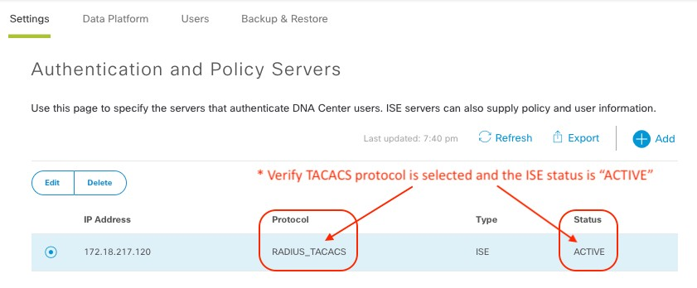

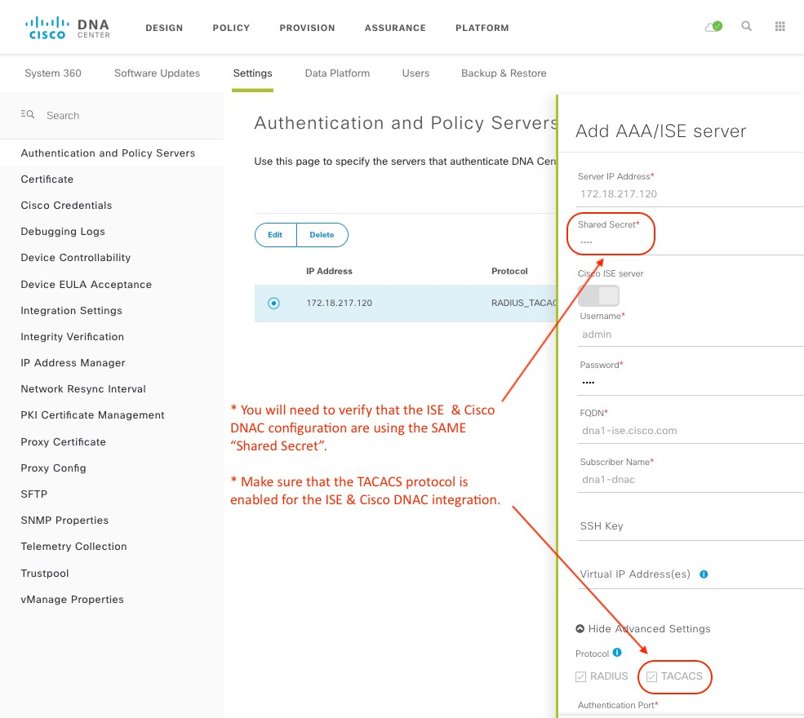
Configure External Authentication with TACACS
Technote of the Day
CISCO SYSTEMS - CX ENTERPRISE NETWORKING
tdeleon@cisco.com

Slide 4

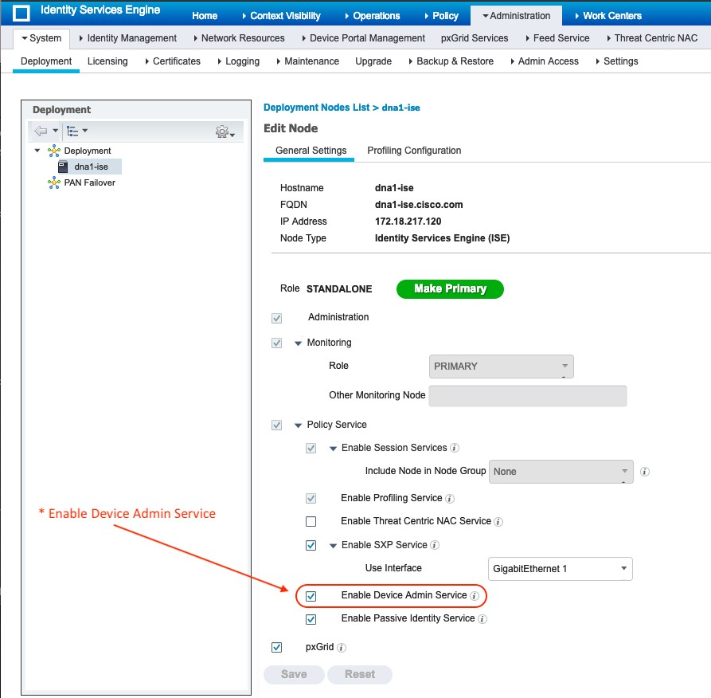
Configure External Authentication with TACACS
Technote of the Day
TASK_2 - CONFIGURE CISCO ISE FOR TACACS AUTHORIZATION & AUTHENTICATION FOR THE CISCO DNAC.
Step 1: Enable Device Admin Service
Administration → System → Deployment , "Enable Device Admin Service" as shown in below snapshot:
tdeleon@cisco.com

Slide 5

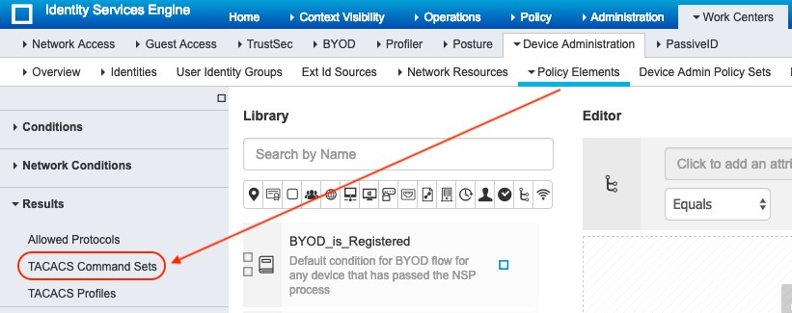

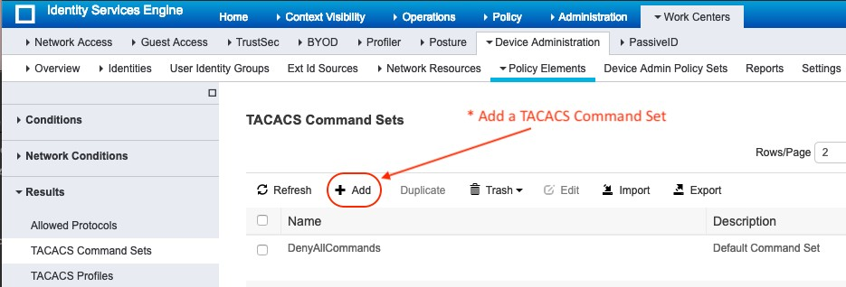
Configure External Authentication with TACACS
Technote of the Day
Step 2: Configure TACACS Command Sets
Under Work Centers → Device Administration → Policy Elements → Results → TACACS Command Sets
→ add the command set and select "Permit any command that is not listed below" option.
tdeleon@cisco.com

Slide 6

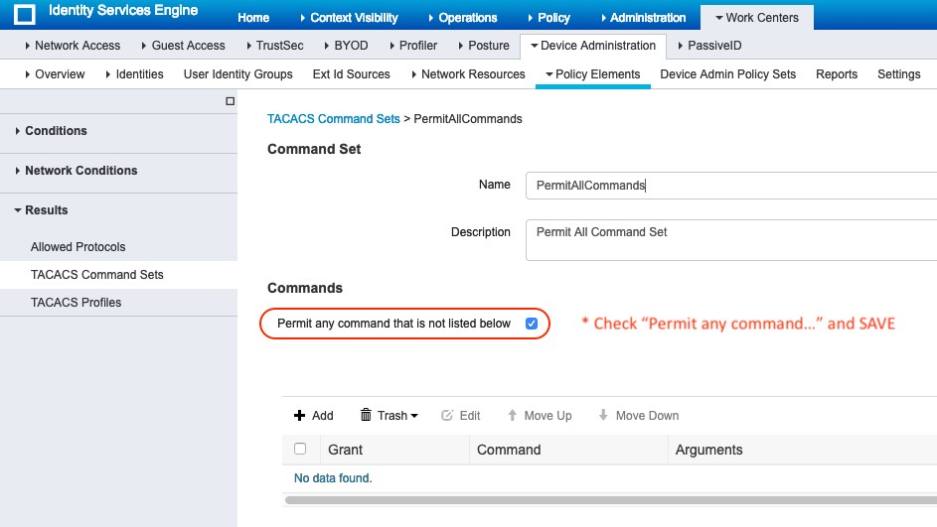

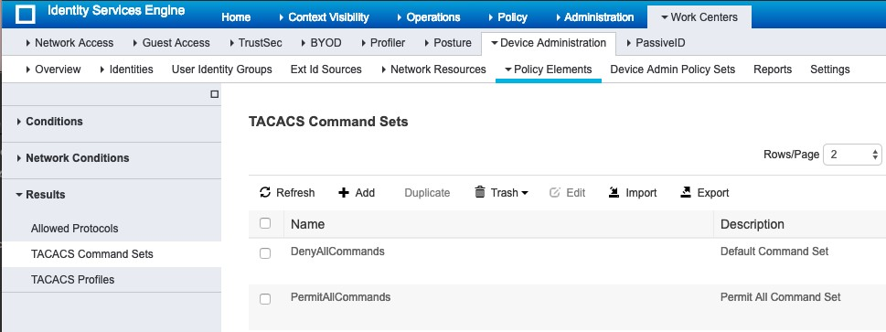
Configure External Authentication with TACACS
Technote of the Day
Step 2: Configure TACACS Command Sets (cont.)
tdeleon@cisco.com

Slide 7

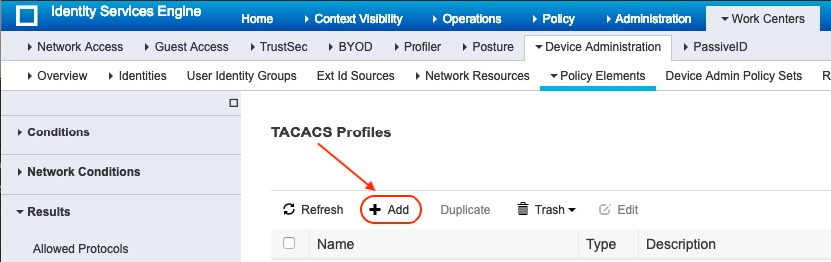
Configure External Authentication with TACACS
Technote of the Day
Step 3: Configure TACACS Profiles
Under Work Centers → Device Administration → Policy Elements add details as mentioned below & mention "cisco-av-pair" or "Cisco-AVPair" with required Role value.
The value provided here for "Role" will be validated against the Roles that exist in the Cisco DNAC, hence the values specified here should be valid roles.
NOTE: The Custom Attribute is what is “sent” to the Cisco DNAC. The “Syntax” of the cisco av pair that is configured here depends on what the Cisco DNAC is expecting. Please refer to the Cisco DNAC configuration for the “AAA Attribute” section for more details.
tdeleon@cisco.com

Slide 8

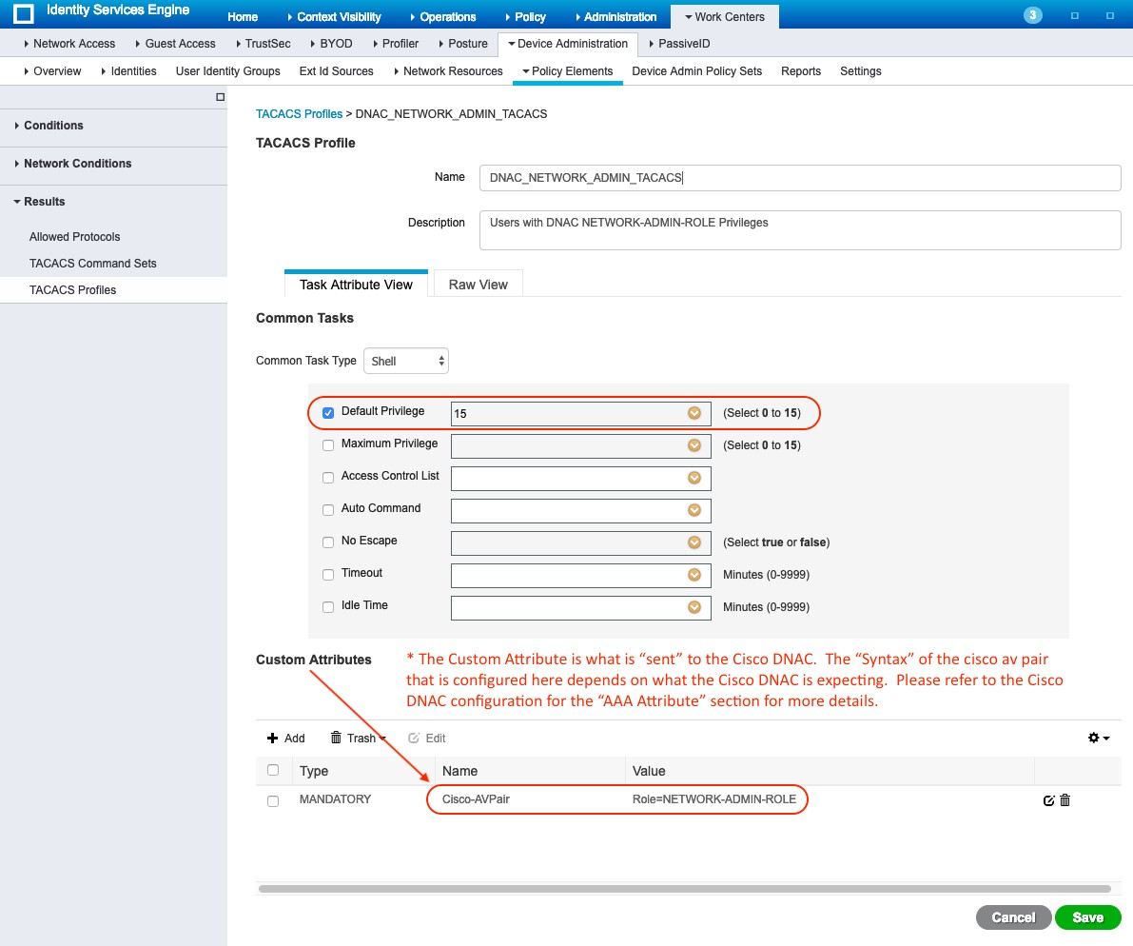

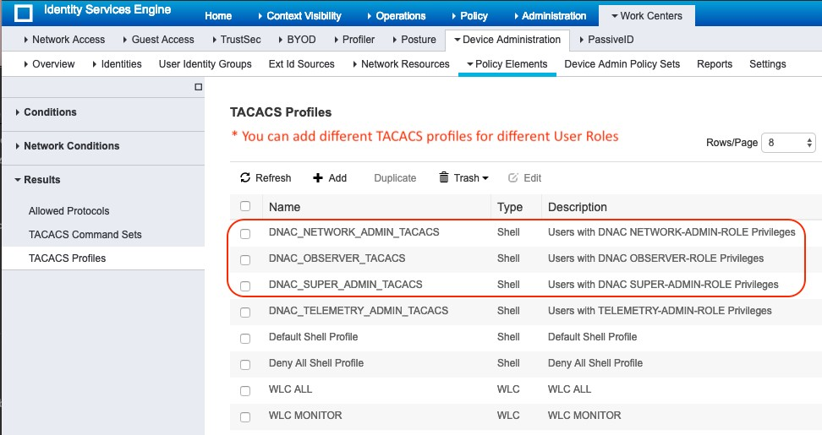
Configure External Authentication with TACACS
Technote of the Day
tdeleon@cisco.com

Slide 9

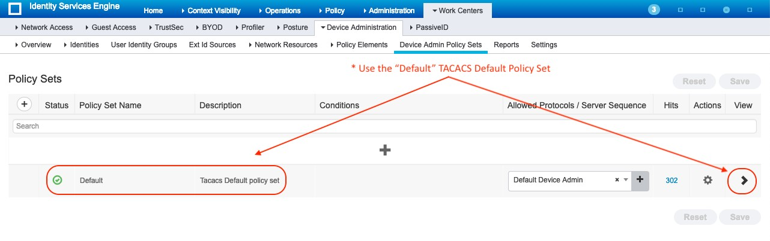

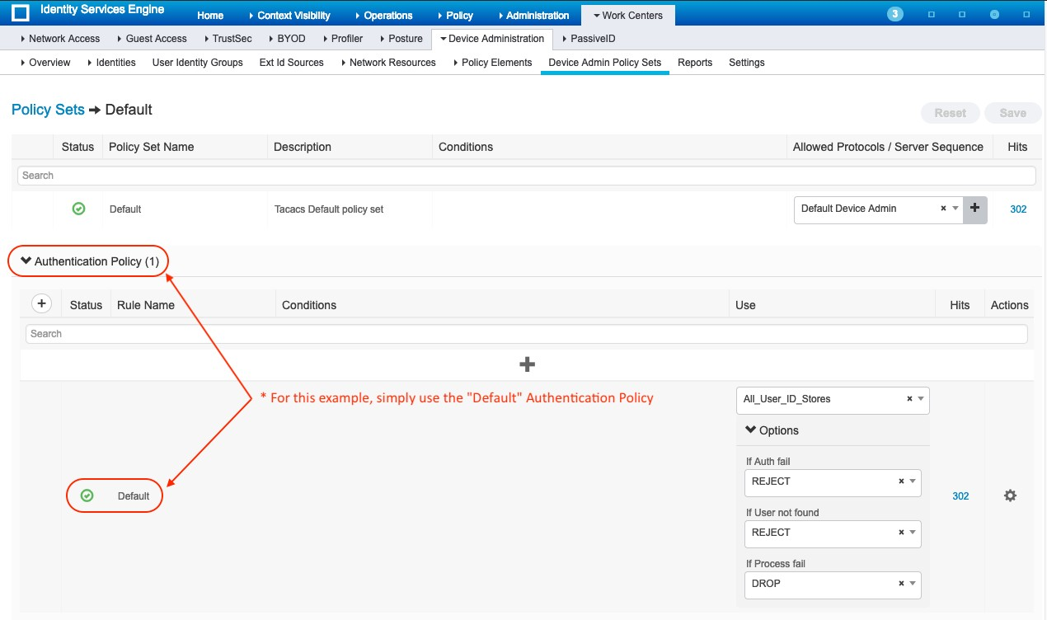
Configure External Authentication with TACACS
Technote of the Day
Step 4: Configure Authentication & Authorization Policies for TACACS
Under Work Center → Device Administration → Device Admin Policy Set → Default →
"Authentication Policy"
For this example, simply use the "Default" Authentication Policy
tdeleon@cisco.com

Slide 10

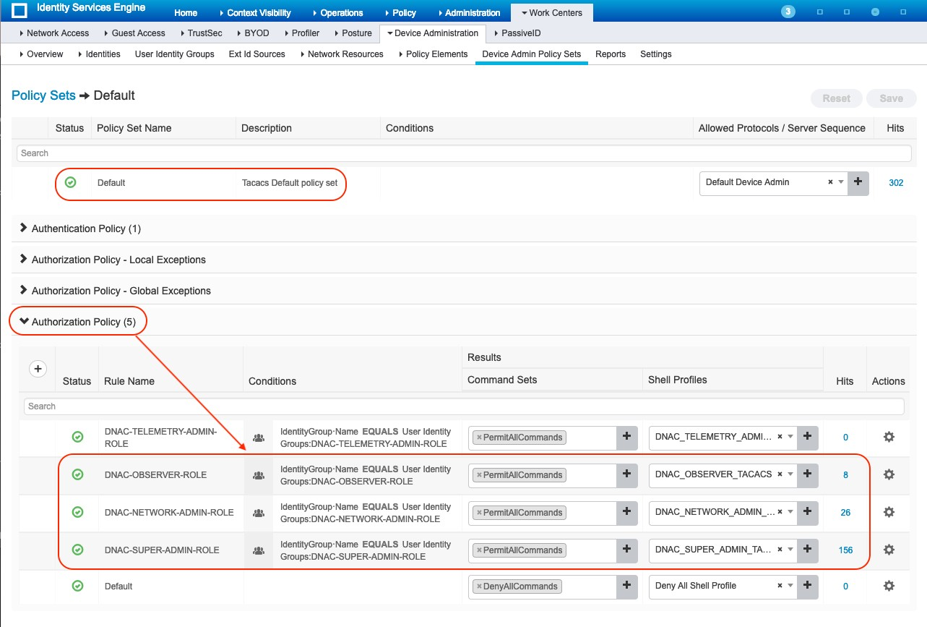

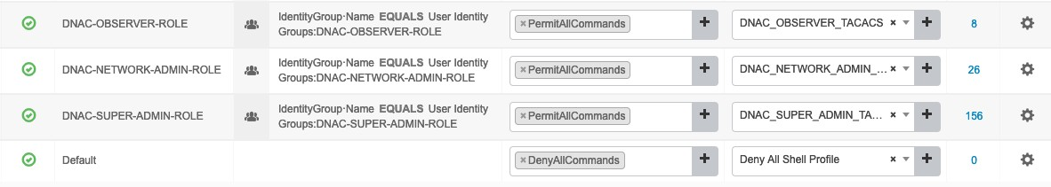
Configure External Authentication with TACACS
Technote of the Day
"Authorization Policy"
& create required Authorization Rules & mention the Shell profile created in previous steps.
As part of condition, associate to users. These users will be created as shown in step 6.
tdeleon@cisco.com

Slide 11

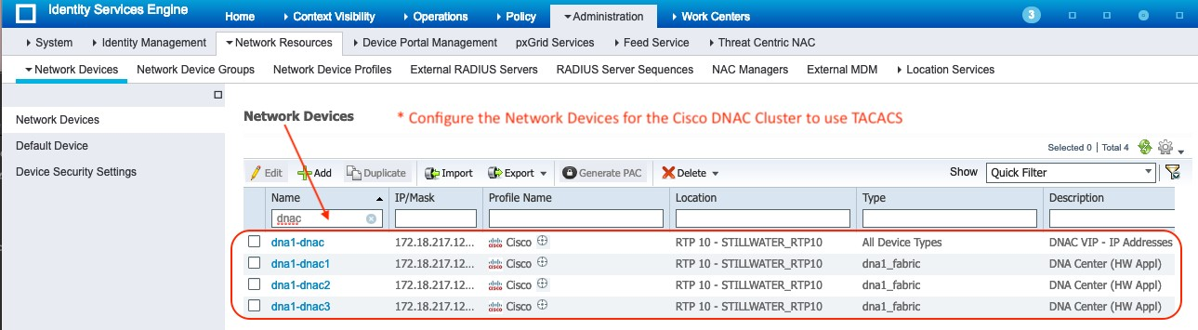

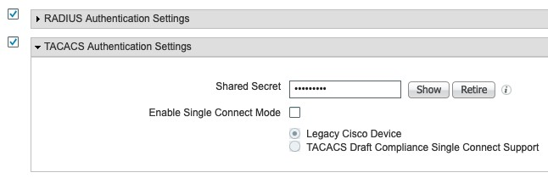
Configure External Authentication with TACACS
Technote of the Day
Step 5: Configure the Network Devices for the Cisco DNAC Cluster to use TACACS
Under Administration → Network Resources → Network Devices, select the defined Cisco DNAC Device entries.
Note: If a Network Device is not present, Add a Network Device for "each" Cisco DNAC in the Cluster. In addition, Add a Network Device for the Virtual IPs (VIPs).
Under Administration → Network Devices , select "Enable TACACS" and configure the Shared Secret value - which will be used while configuring the ISE on DNAC Common Settings page.
If specific device/IP address entries are present in "Network Devices" tab, enable TACACs settings there as well.
tdeleon@cisco.com

Slide 12

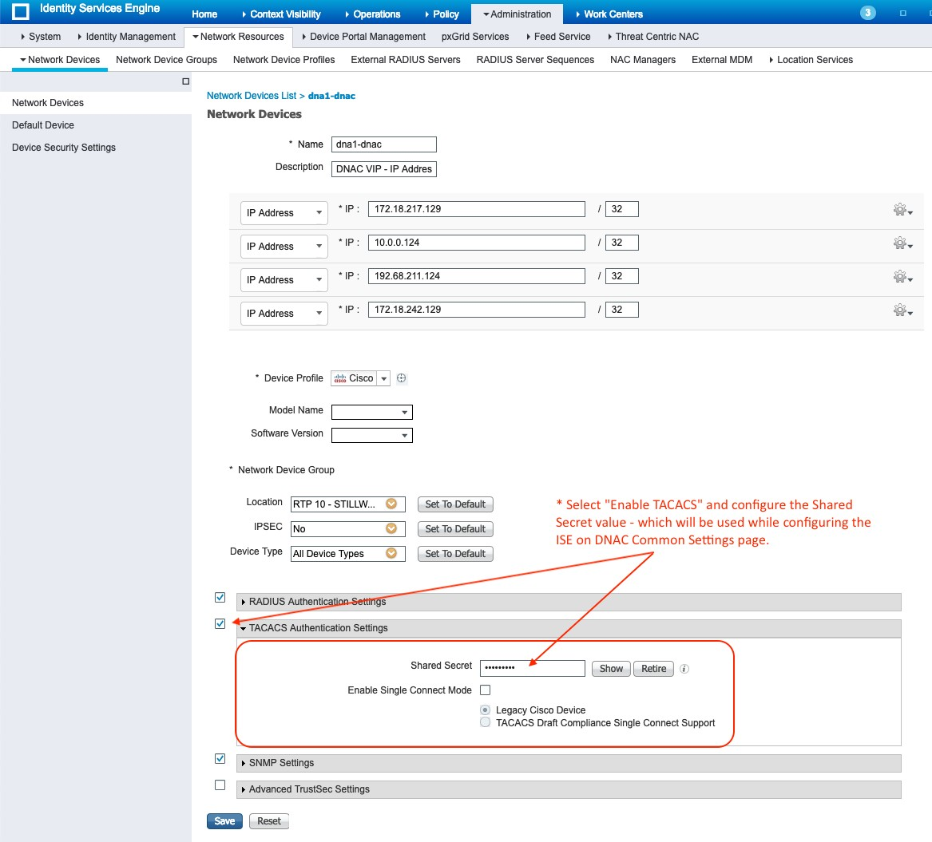
Configure External Authentication with TACACS
Technote of the Day
tdeleon@cisco.com

Slide 13

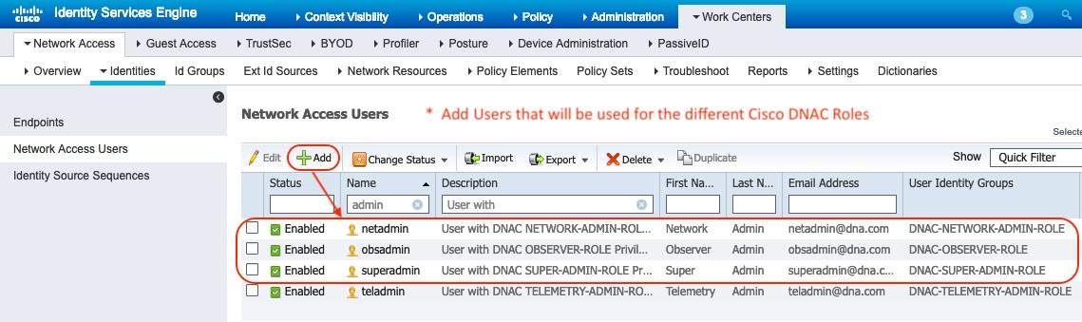

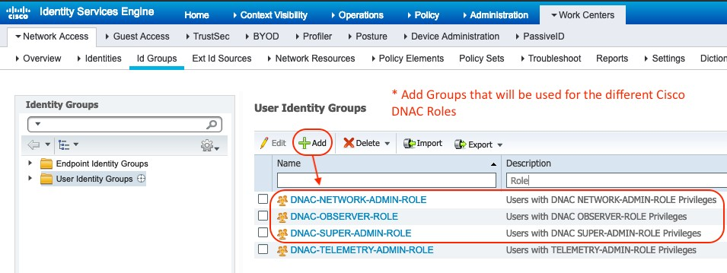
Configure External Authentication with TACACS
Technote of the Day
Step 6: Add Users & Groups that will be used for the diﬀerent Cisco DNAC Roles
Under Work Center → Network Access → Identities → Network Access Users → click Add & mention the details as shown below :
Under Work Center → Network Access → Id Groups → User Identity Groups → click Add & mention the details as shown below :
tdeleon@cisco.com

Slide 14

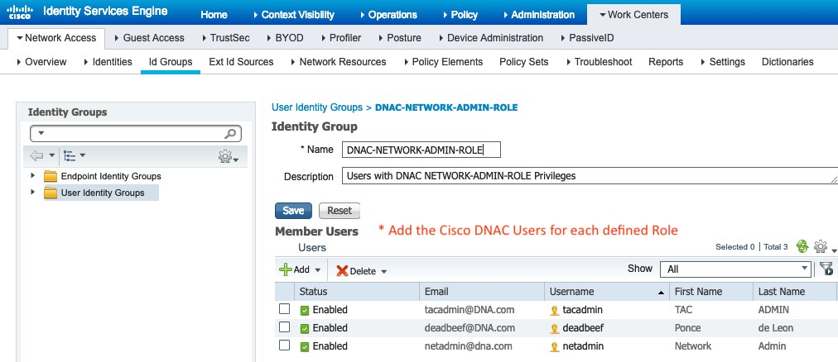
Configure External Authentication with TACACS
Technote of the Day
tdeleon@cisco.com

Slide 15

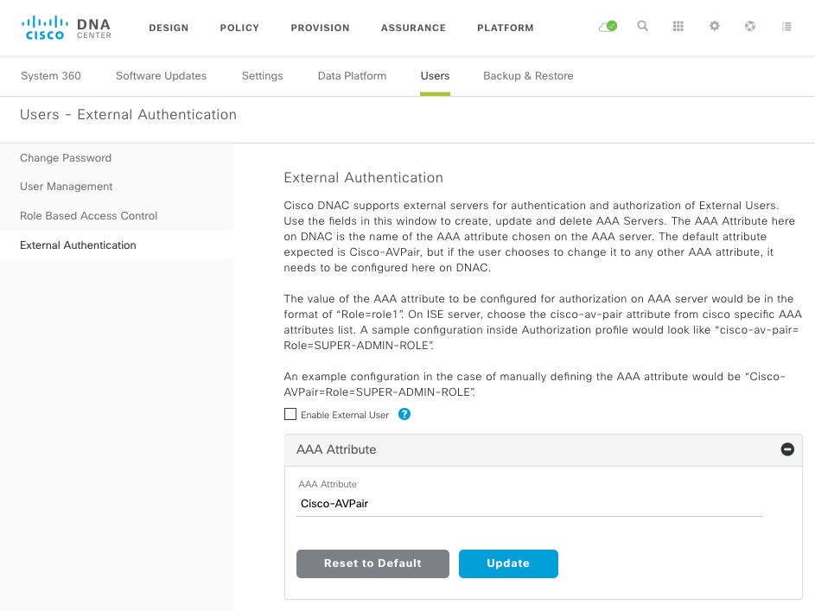
Configure External Authentication with TACACS
Technote of the Day
TASK_3 - CONFIGURE CISCO DNAC USER MANAGEMENT FOR EXTERNAL AUTHENTICATION USING TACACS.
From the Cisco DNAC GUI, Goto -> System Settings-> Users-> External Authentication
This task is important to pay attention to each step that you perform when enabling external authentication. The AAA Attribute value for "cisco av pair" can change based on an action that you perform. The AAA Attribute value that you configured in TASK_2 needs to match what the Cisco DNAC is expecting for the authentication credentials exchange.
The default attribute expected for Cisco-AVPair is "cisco-av-pair".
tdeleon@cisco.com

Slide 16

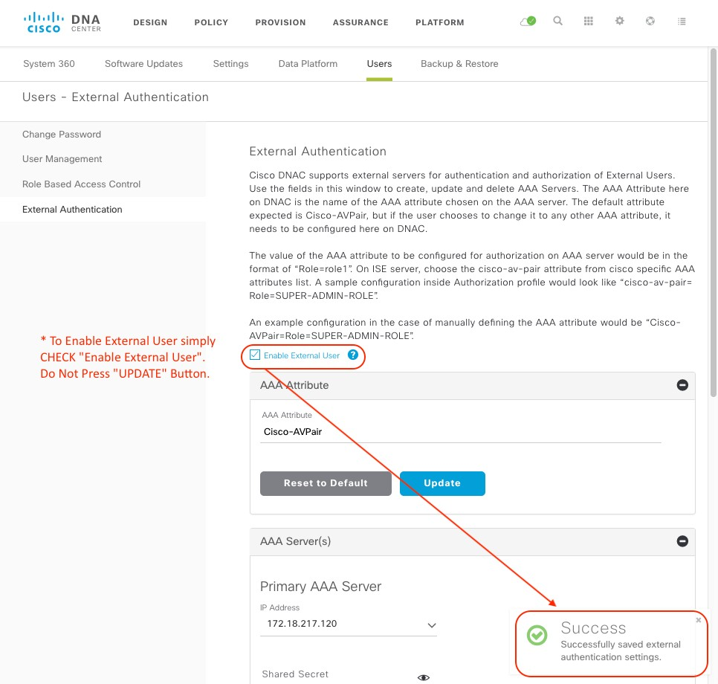
Configure External Authentication with TACACS
Technote of the Day
Step 1: Enable External User Authentication
To Enable External User simply CHECK "Enable External User". Do Not Press "UPDATE" Button. The Cisco DNAC will notify configuration with the message "Success: Successfully saved external authentication settings."
tdeleon@cisco.com

Slide 17





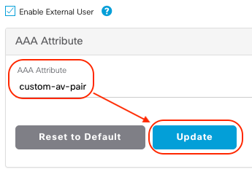
Configure External Authentication with TACACS
Technote of the Day
If you checked "Enable External User" and Do Not Press "UPDATE" Button, the following is the syntax used when configuring the ISE TACACS Profile. This is the "Original" DEFAULT AAA Attribute value.
cisco-av-pair ROLE=NETWORK-ADMIN-ROLE
Gotcha_1: If you checked "Enable External User" and then Pressed "UPDATE" Button, the following is the syntax used when configuring the ISE TACACS Profile. This is the "New" DEFAULT AAA Attribute value.
Cisco-AVPair Role=NETWORK-ADMIN-ROLE
Option_2: If you checked "Enable External User", Changed the AAA Attribute, and then Pressed "UPDATE" Button, the following is the syntax used when configuring the ISE TACACS Profile. For this example. "custom-av-pair" is the AAA Attribute value.
custom-av-pair Role=NETWORK-ADMIN-ROLE
tdeleon@cisco.com

Slide 18



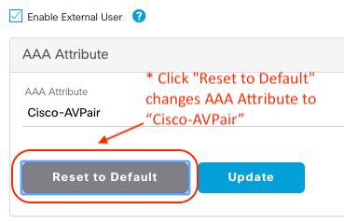

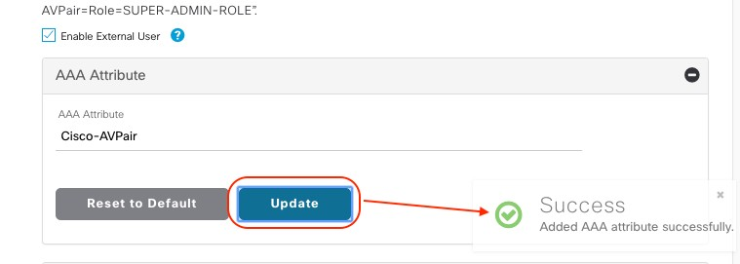
Configure External Authentication with TACACS
Technote of the Day
Gotcha_2: If you changed the AAA Attribute to and you want to reset the AAA Attribute BACK TO THE DEFAULT value, perform the following:
Click "Reset to Default”
Click "Update"
tdeleon@cisco.com

Slide 19

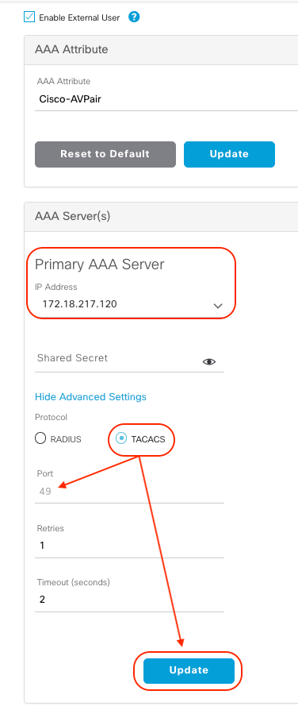
Configure External Authentication with TACACS
Technote of the Day
The gotcha is that the "New" DEFAULT AAA Attribute value is "Cisco-AVPair" not the original DEFAULT of "cisco-av-pair". So in ISE, configure:
Cisco-AVPair Role=NETWORK-ADMIN-ROLE
Step 2: Select AAA Server(s) to be used for External Authentication using TACACS
Under the AAA Server(s) section, select the ISE Server.
Note: If the server(s) is not listed in the dropdown, try refreshing the browser to re-list avalable servers.
Select TACACS Protocol.
Note: The TACACS protocol port number is 49. This is not configurable in Cisco DNAC version 1.2.8 or later.
Click UPDATE to save changes
tdeleon@cisco.com

Slide 20

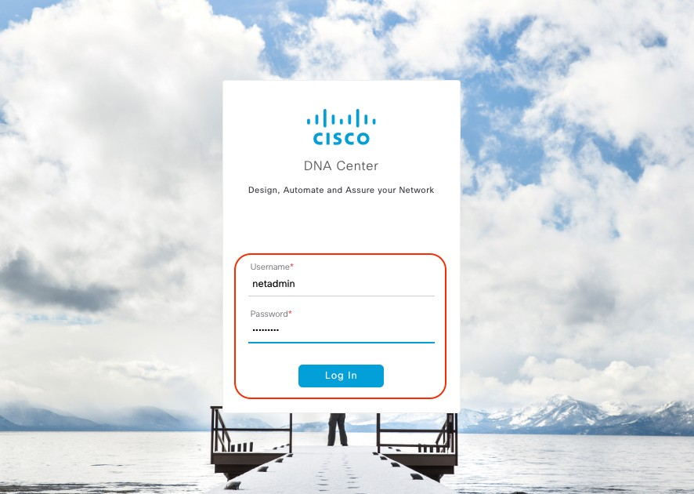
Configure External Authentication with TACACS
Technote of the Day
TASK_4 - VERIFY CISCO DNAC USER MANAGEMENT FOR EXTERNAL AUTHENTICATION USING TACACS WITH CISCO ISE.
Sign out of the Cisco DNAC GUI
Login into the Cisco DNAC GUI using one of the Users that you configured earlier.
tdeleon@cisco.com

Slide 21

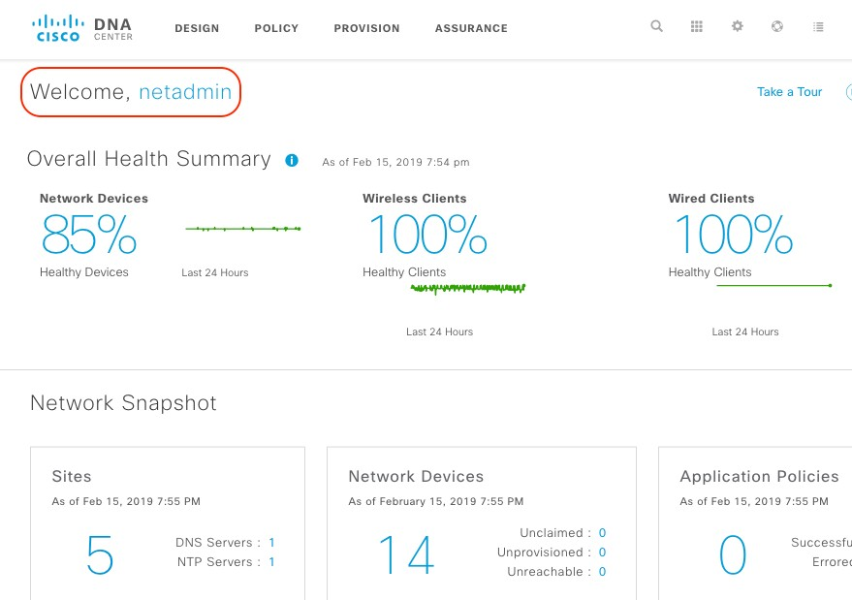

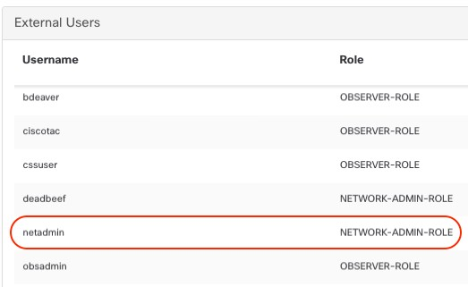
Configure External Authentication with TACACS
Technote of the Day
From the Cisco DNAC GUI, Goto -> System Settings-> Users-> External Authentication
Look at the External Users list. You should see the TACACS users listed and their assigned roles.
tdeleon@cisco.com

Slide 22

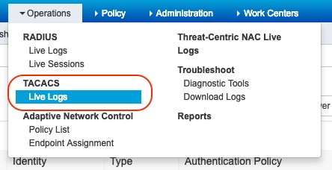

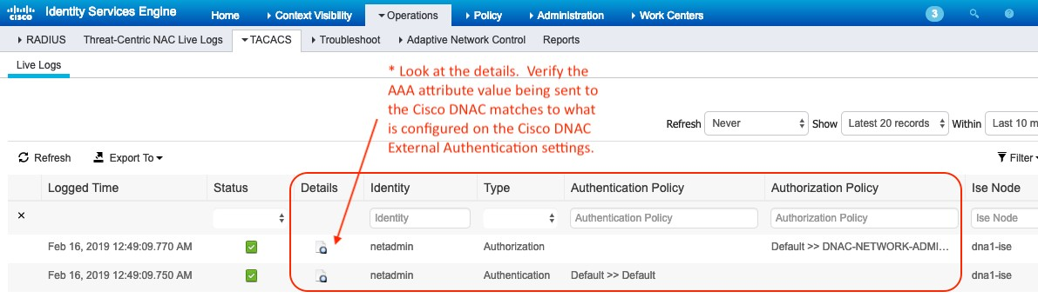
Configure External Authentication with TACACS
Technote of the Day
APPENDIX - TROUBLESHOOTING.
On the ISE, Start your troubleshooting by looking at the TACACS Live Logs. Verify the ISE is sending the correct "cisco av pair" to the Cisco DNAC Cluster.
tdeleon@cisco.com

Slide 23

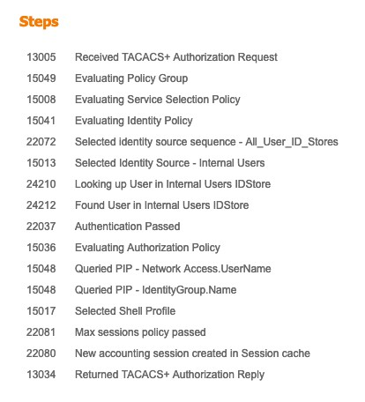

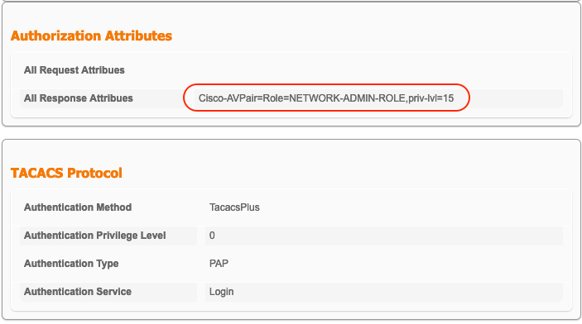
Configure External Authentication with TACACS
Technote of the Day
tdeleon@cisco.com

Slide 24

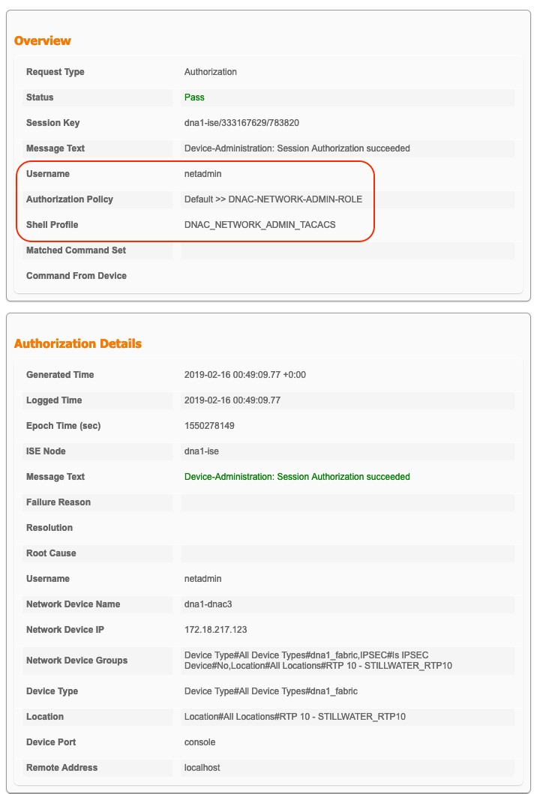
Configure External Authentication with TACACS
Technote of the Day
tdeleon@cisco.com

Slide 25

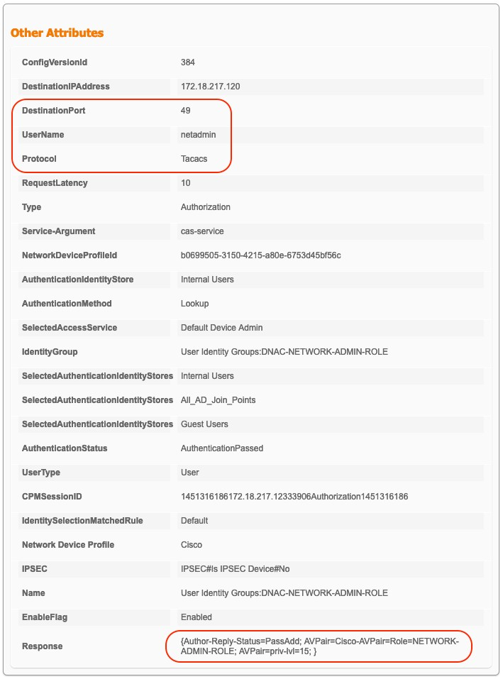
Configure External Authentication with TACACS
Technote of the Day
tdeleon@cisco.com

Slide 26
Configure External Authentication with TACACS
Technote of the Day
On the Cisco DNAC CLI, you can also check some logs for possible issues:
$ magctl appstack status | egrep "identitymgmt"
$ magctl service logs -rf identitymgmt-1140144783-m3d12 -c identitymgmt
## User_ID that is failing is "netadmin"
$ sudo grep -RHIrnis "netadmin" /var/log/pods
For Example:
FAILED - Login
$ magctl appstack status | egrep "identitymgmt"
maglev-system maglev-system
identitymgmt-1140144783-107fz identitymgmt-1140144783-m3d12
$ magctl service logs -rf identitymgmt-1140144783-m3d12 -c identitymgmt
{"timeMillis":
1550280597257,"thread":"qtp864326906-31","level":"ERROR","loggerName":"com.cisco. maglev.services.IdentityAccessManager","message":"Authentication has failed.
Please provide valid
credentials.","endOfBatch":false,"loggerFqcn":"org.apache.logging.slf4j.Log4jLogg er","threadId":31,"threadPriority":5}
{"timeMillis":
1550280597257,"thread":"qtp864326906-31","level":"ERROR","loggerName":"com.cisco. maglev.services.IdentityAccessManager","message":"Authentication has failed.
Please provide valid
credentials.","endOfBatch":false,"loggerFqcn":"org.apache.logging.slf4j.Log4jLogg er","threadId":31,"threadPriority":5}
tdeleon@cisco.com

Slide 27
Configure External Authentication with TACACS
Technote of the Day
{"timeMillis":
1550280597257,"thread":"qtp864326906-31","level":"ERROR","loggerName":"com.cisco. maglev.identitymgmt.api.TokenEndPoint","message":"Authentication has failed.
Please provide valid credentials.","endOfBatch":false,"loggerFqcn":"org.apache.logging.slf4j.Log4jLogg er","threadId":31,"threadPriority":5}
$ sudo grep -RHIrnis "netadmin" /var/log/pods
/var/log/pods/5bc407de-04e5-11e9-89d8-b4de31bd7aa0/cas-service_0.log:455:
{"log":"17:57:53.242 [qtp1394438858-19298] ERROR
com.cisco.maglev.radius.utils.CustomJRadiusServerImpl - Error while getting AAA Server details : User (netadmin) not authenticated.
\n","stream":"stdout","time":"2019-01-03T17:57:53.242826244Z"}
/var/log/pods/5bc407de-04e5-11e9-89d8-b4de31bd7aa0/cas-service_0.log:455:
{"log":"17:57:53.242
$ sudo cat ./5bc407de-04e5-11e9-89d8-b4de31bd7aa0/cas-service_0.log | egrep "17:57:53."
{"log":"TACACS+: Connected to server at 172.18.217.120:49\n","stream":"stdout","time":"2019-01-03T17:57:53.128949781Z"}
{"log":"17:57:53.210 [qtp1394438858-19298] ERROR
com.cisco.maglev.tacacs.TacacsAuthentication -
authenSessioncom.augur.tacacs.SessionClient@2bd3a42e\n","stream":"stdout","time": "2019-01-03T17:57:53.211242995Z"}
{"log":"17:57:53.242 [qtp1394438858-19298] ERROR
com.cisco.maglev.radius.utils.CustomJRadiusServerImpl - Error while getting AAA Server details : User (netadmin) not authenticated.
\n","stream":"stdout","time":"2019-01-03T17:57:53.242826244Z"}
tdeleon@cisco.com

Slide 28
Configure External Authentication with TACACS
Technote of the Day
Successful Login
{"timeMillis":
1550281951650,"thread":"qtp864326906-31","level":"INFO","loggerName":"com.cisco.m
aglev.identitymgmt.api.TokenEndPoint","message":"JWT token is generated successfully.","endOfBatch":false,"loggerFqcn":"org.apache.logging.slf4j.Log4jLog ger","threadId":31,"threadPriority":5}
{"timeMillis":
1550281951650,"thread":"qtp864326906-31","level":"INFO","loggerName":"com.cisco.m
aglev.identitymgmt.api.TokenEndPoint","message":"Cookie is set successfully.","endOfBatch":false,"loggerFqcn":"org.apache.logging.slf4j.Log4jLog ger","threadId":31,"threadPriority":5}
{"timeMillis":
1550281951651,"thread":"qtp864326906-31","level":"INFO","loggerName":"com.cisco.m aglev.identitymgmt.api.TokenEndPoint","message":"'netadmin' logged in
successfully.","endOfBatch":false,"loggerFqcn":"org.apache.logging.slf4j.Log4jLog ger","threadId":31,"threadPriority":5}
{"timeMillis":
1550281953112,"thread":"qtp864326906-32","level":"INFO","loggerName":"com.cisco.m aglev.sdk.persistence.document.BaseDocumentDao","message":"The number of entities found is
15","endOfBatch":false,"loggerFqcn":"org.apache.logging.slf4j.Log4jLogger","threa dId":32,"threadPriority":5}
timeMillis":
1550281951651,"thread":"qtp864326906-31","level":"INFO","loggerName":"com.cisco.m aglev.identitymgmt.api.TokenEndPoint","message":"'netadmin' logged in successfully.","endOfBatch":false,"loggerFqcn":"org.apache.logging.slf4j.Log4jLog ger","threadId":31,"threadPriority":5}
{"timeMillis":
1550281953112,"thread":"qtp864326906-32","level":"INFO","loggerName":"com.cisco.m
aglev.sdk.persistence.document.BaseDocumentDao","message":"The number of entities found is 15","endOfBatch":false,"loggerFqcn":"org.apache.logging.slf4j.Log4jLogger","threa dId":32,"threadPriority":5}
tdeleon@cisco.com

